Slide 1

THE MAP TYPE
MADHUMITHA.S
19PW13

Slide 2
WHAT A MAP TYPE IS ?
A map is a collection of key-value pairs . The map type is often referred to as an associative array : it is like the built in array type , in that the key can be used as an index to fetch an array . In this, values are associated with a particular key rather than being fetched by position in the array.
Array : a[10]=8;
A map : a[“string1”]=8;

Slide 3
Defining a map
To use a map, we must include the map header(#include<map>)
when we define a map object we must indicate both the key and the value type :
example 1 : map < string , int > obj1;
//defines an empty map which is indexed by a string and holds associated integer values
example 2 : map < int , int >obj2;
//defines an empty map which is indexed by an integer and holds associated integer values

Slide 4
CONSTRUCTORS FOR THE MAP
map <k ,v> m ;
//empty map named m with key and value types k,v respectively
map<k , v> m(m2) ;
//creates m as a copy of m2
map <k ,v> m(b , e) ;
//create m as copy of elements from range denoted by iterators b and e.Elements
Must have the type that can be converted to pair<const k, v>

Slide 5
Map initialisation
Map<string,string> m {
{“Tom”,”butcher”},
{“Anne”,”baker”},
{“George”,”Candlestick maker”}
};

Slide 6
Map initialisation and Adding elements to the map
Once the map is defined next step is to populate it with a key value element pairs. This is done through “insert” member or simple initialisation.
Any element of map can be reassigned with a value by fetching an element using the subscript and assigning the new value to it.
Map<string,string> m {
{“Tom”,”Butcher”},
{“Anne”,”Baker”},
{“George”,”Candlestick maker”}
};
m[“Frank”]=“Teacher”; //insert

Slide 7
Using insert instead of subscripting
When we use a subscript to add an element to the map,the value part of the element is value initialised.in this,we initialise and assign the same object.
Adding it directly into the map :
m.insert(map<string,int>: :value_type(“kin”,10));
or
m.insert(“kin”,10);
//here value type is the synonym for the type pair<const K , V >,where K is the key type and v is the type of the associated value
//the argument to insert constructs a new object of the appropriate pair type

Slide 8
USING THE VALUE RETURNED FROM SUBSCRIPT OPERATION
Map<string,string> m {
{“Tom”,”butcher”},
{“Anne”,”baker”},
{“George”,”Candlestick maker”},
{“Frank”,”Teacher”}
};
m[“Tom”]=“Instructor”; //update value
m.at(“Frank”)=“Professor”; //update value

Slide 9
FINDING AND RETRIEVING A MAP ELEMENT
1.using a subscript :
map< string , int > m;
int occurs=m[“foot”];
//here,subscript results in an important side effect which is insertion of the element we want to check.by default,value of a key -value pair is set to zero if no value is defined.thus,the value of occurs become 0.
2.Count and find operations :
int a;
a=m.count(“foot”); //count operation returns 0 if found ,1 if not found
map< string , int > :: iterator it = m.find(“foot”);
if(it!=m.end())
a=it->second;

Slide 10
Erasing an element from map
There are 3 variants of the erase operation to remove elements from a map.
1.m.erase(k)
//removes the element with the key k from m . returns integer indicating the number of elements removed
2.m.erase(p)
//removes element referred to by the iterator p from m . p must refer to an actual element in m,it must not be equal to m.end().returns void.
3.m.erase(b,e)
//removes the elements in the range denoted by the iterator pair b , e. b and e must be a valid range of elements in m : b and e must refer to elements in m or 1 past the last element in m.b and e must either be equal-in which case the range is empty-or the element to which b refers must occur before the element referred to by e.returns void

Slide 11
Iterating across a map
//get iterator positioned on the first element
map < string , int > : : const_iterator
map_it=m.begin();
//const iterator-A constant iterator is one that can be used for access only, and cannot be used for
modification
//print key value pairs of each element in the map
while(map_it != m.end() )
{
cout<<map_it->first <<“,”<<map_it->second;
++map-it; //increment iterator to denote the next element
}

Slide 12
Some basic functions associated with map
begin() – Returns an iterator to the first element in the map end() – Returns an iterator to the theoretical element that follows last element in the map size() – Returns the number of elements in the map max_size() – Returns the maximum number of elements that the map can hold empty() – Returns whether the map is empty
Insert pair(keyvalue, mapvalue) – Adds a new element to the map erase(iterator position) – Removes the element at the position pointed by the iterator erase(const g)– Removes the key value ‘g’ from the map clear() – Removes all the elements from the map

Slide 13
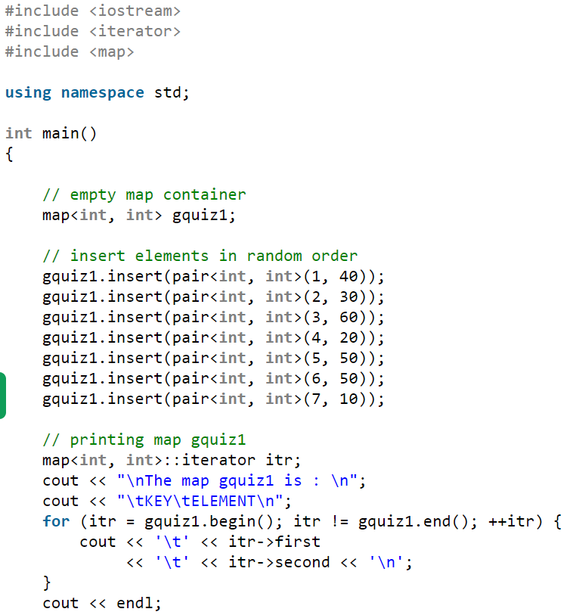

Sample code

Slide 14
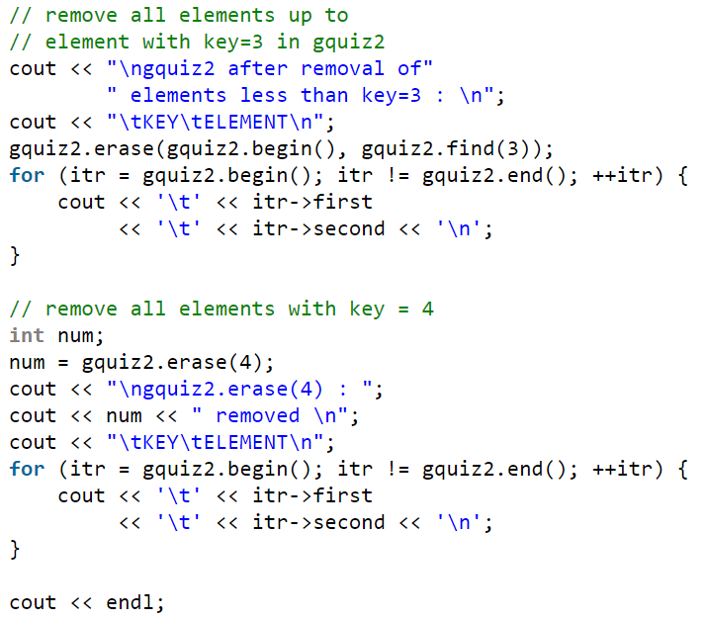
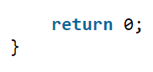
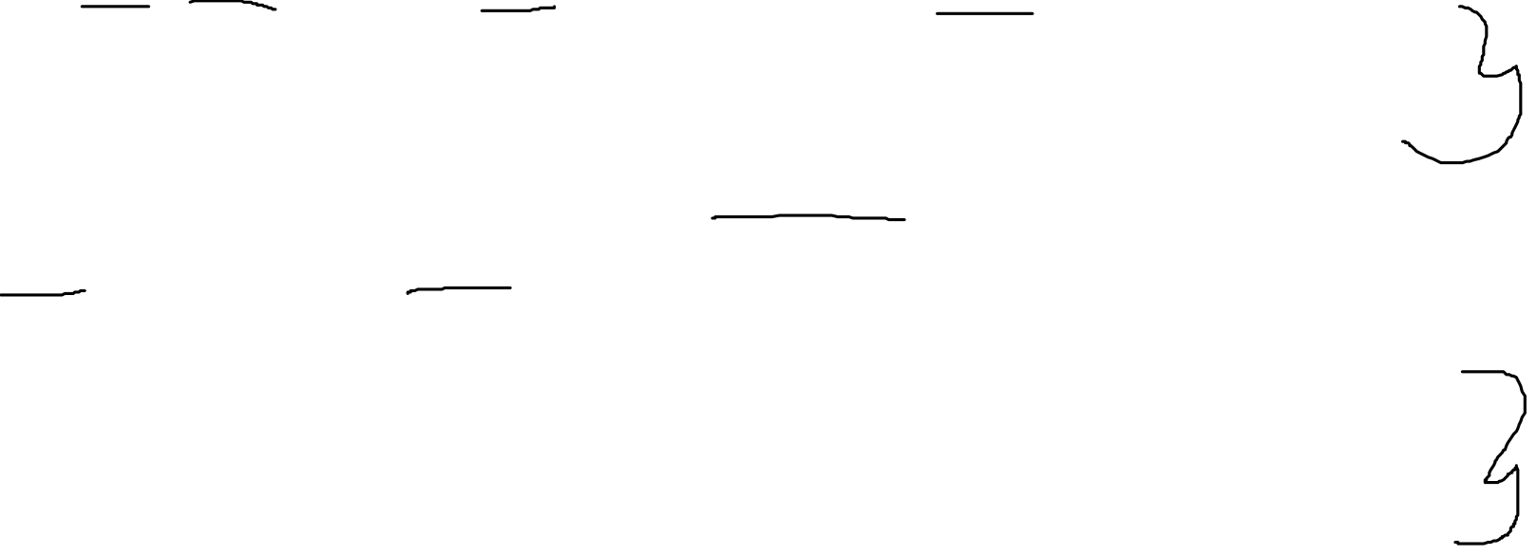

Slide 15
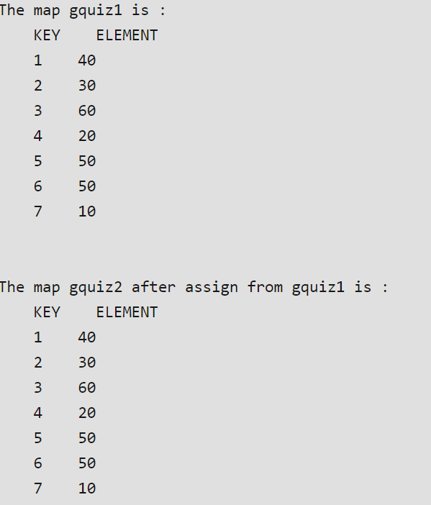
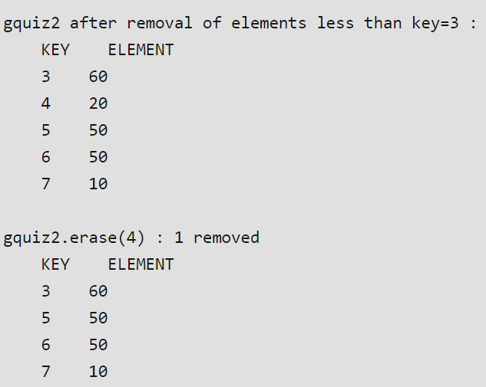
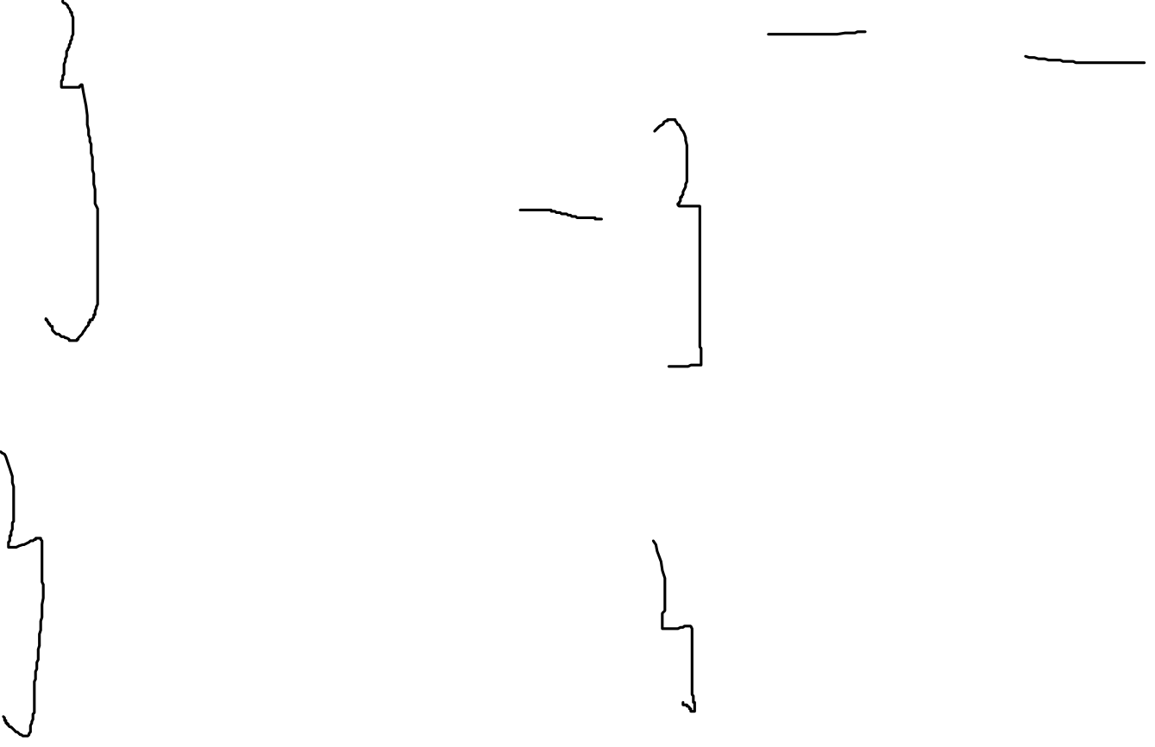
output

Slide 16
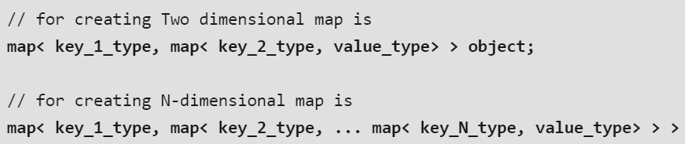
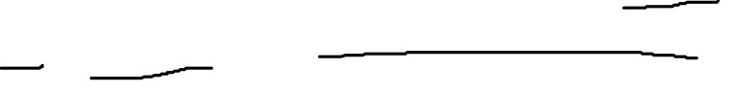
Multidimensional map in c++
A multidimensional map s used when we wanrt to map value to combination of key,here key can be of any datatype or user defined data type.
They are nested map that stores element formed by the combination of a key vlue and a mapped value
SYNTAX :

Slide 17
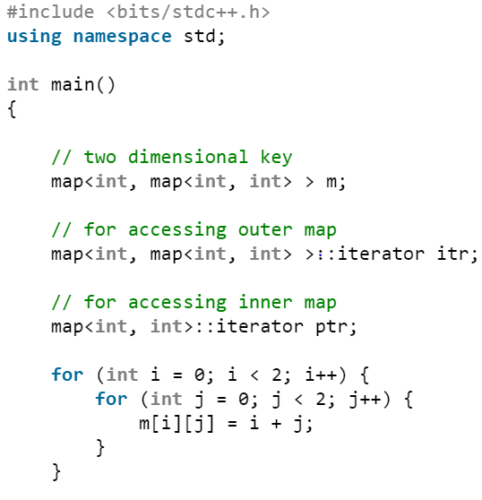
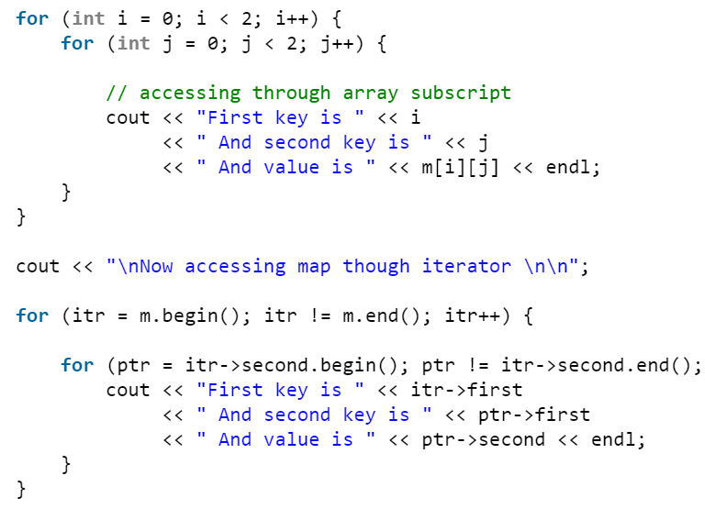
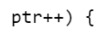


Slide 18
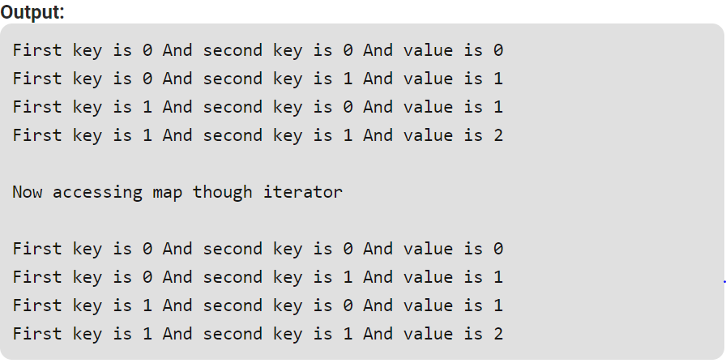

Slide 19
Inserting elements into multidimensional map

Slide 20
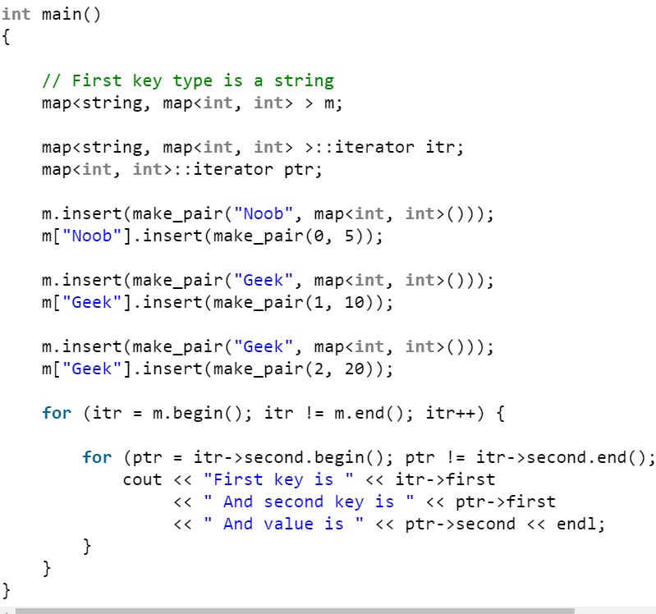
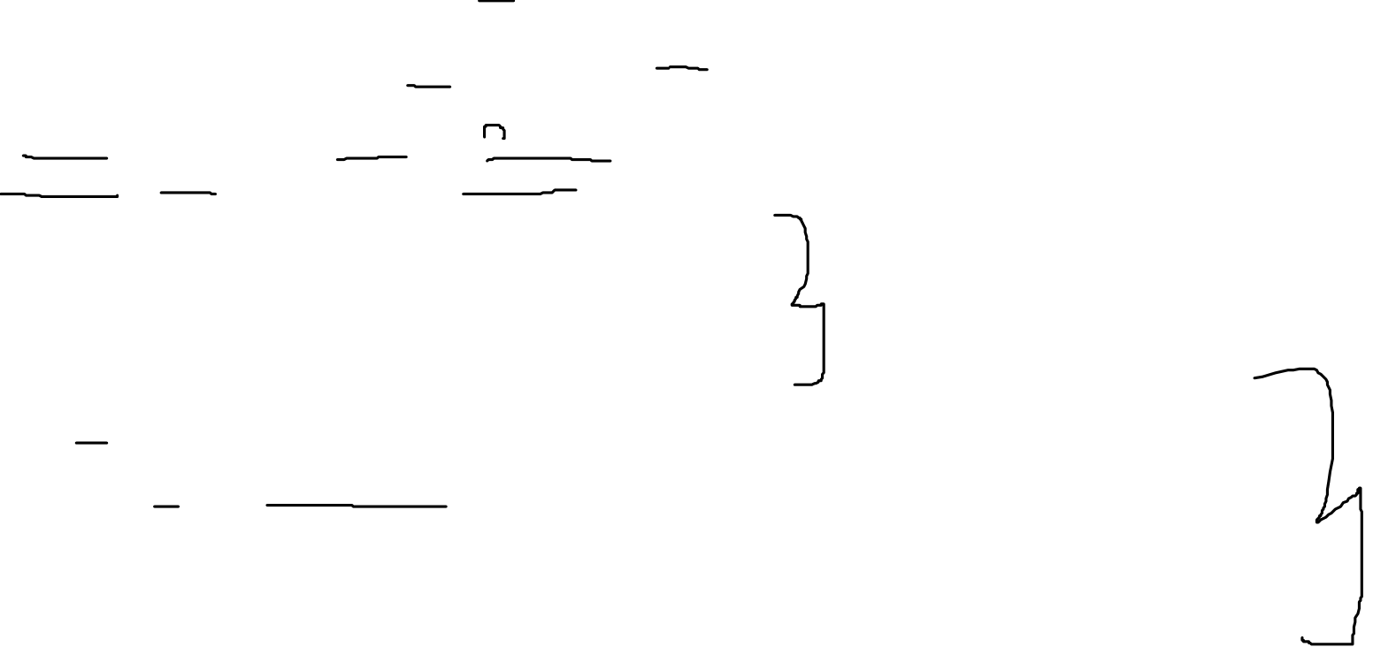

Slide 21
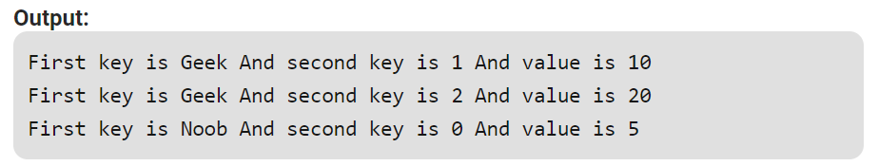

Slide 22
references
C++ primer
authors : Stanley b.Lippman
Josee Lajoie
Barbara E.Moo
https://www.geeksforgeeks.org/

